Slide 1
PM/ScrumMaster Training
BADS Project Delivery Process
January, 2019
Nancy M. Ketchum, PMP, CSM

Slide 2

Project Manager vs. ScrumMaster
They may often be the same person…
Project Managers:
ScrumMasters:
Lead & Drive
Assign
Report
Make Plans
Manage Risks
Avoids Plan Changes
Monitor Team
Coach
Ask for Commitment
Burndown
Execute
Remove Impediments
Embraces Plan Changes
Serve Team

Slide 3
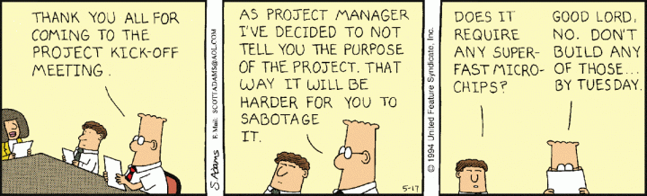

Project Manager vs. ScrumMaster
Project Managers:
ScrumMasters:

Slide 4
Oversight & Administration
BADS Project Delivery Process
Someone’s gotta do it!

Slide 5
Project Oversight & Administration Process
Ensures team has all that is needed to do their work
Keeps work organized
Everyone knows what to do next
Facilitation of difficult or complicated processes
Demonstrable success
Identifies impediments early
Keeps team motivated
Keeps focus on business goals

Slide 6
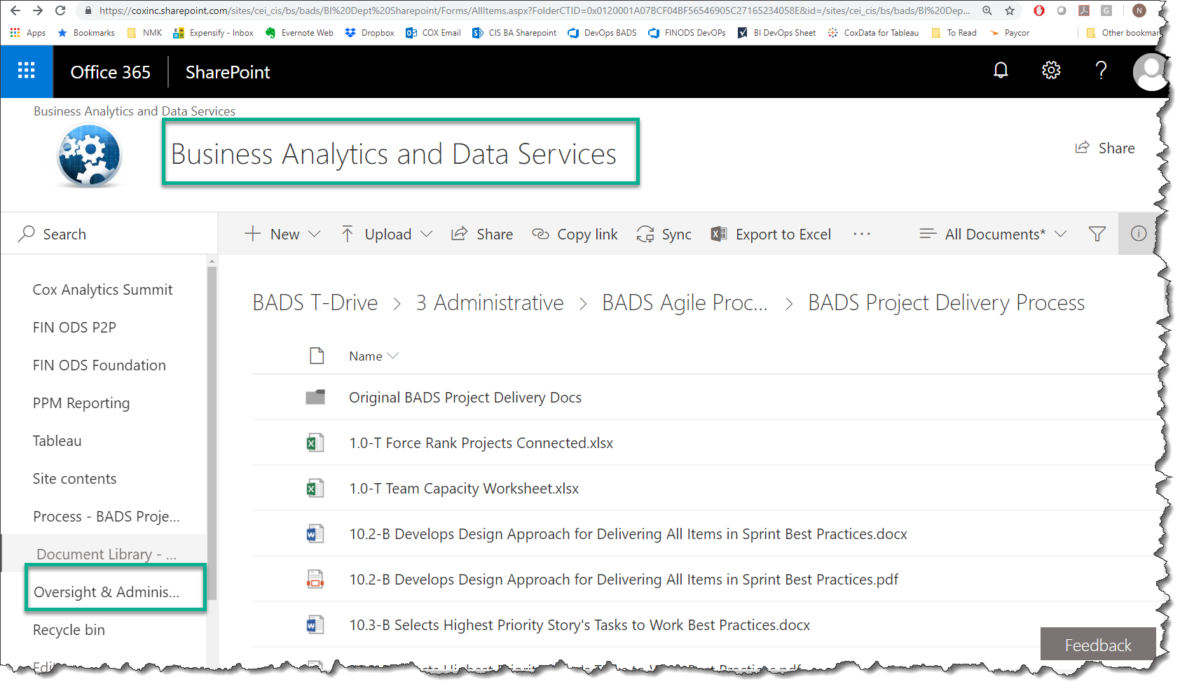

Slide 7
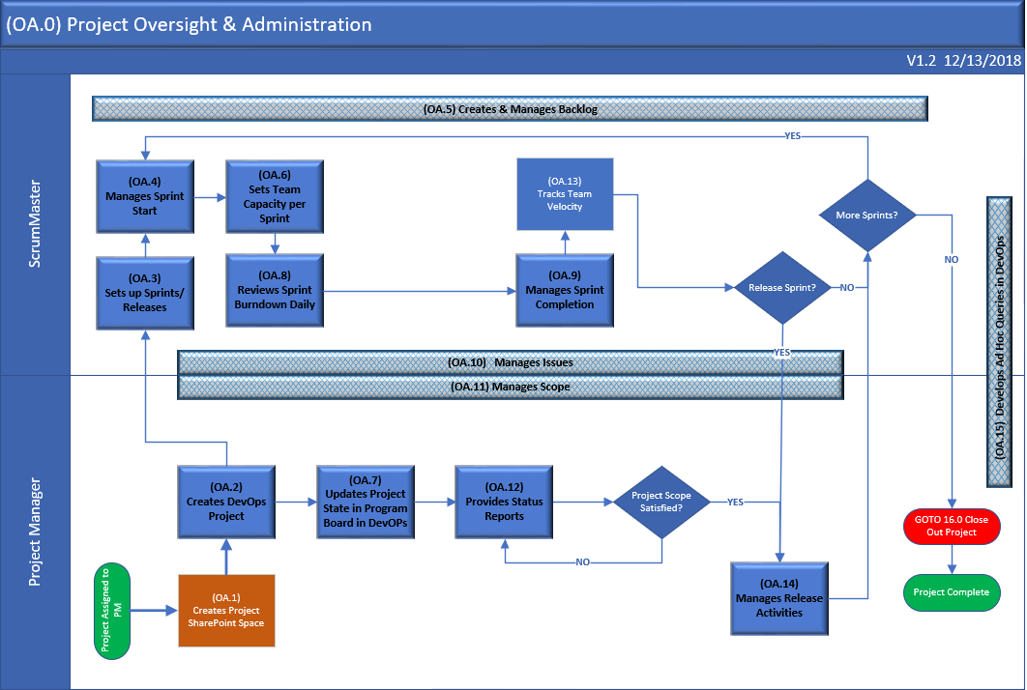

Slide 8
Walk Through
OA.3 – Sets Up Sprints/Releases
Sizing Reference
Update BADS Program
OA.4– Manages Sprint Start
Capacity Template Spreadsheet
PM –Determine Hours Estimated for a Sprint Query
PM – Update Parent Estimates and Calculate Team Member Hours for a Sprint Connected
Enter Capacity for Team
Review Sprint Burndown
OA.5 – Creates and Manages Backlog
Create a Backlog
Use OA.5-T Create Initial Backlog Template
Manage Backlog (second verse same as the first)
OA.8 – Review Sprint Burndown Daily
Walk through the BP document SLOWLY
Review Burndown

Slide 9
Walk Through
OA.9 – Manages Sprint Completion
Close a Non-Release Sprint
PM – Update Complete Sprint Connected Spreadsheet
Update Completed Sprint field
Calculate Velocity
PM – Velocity Each Sprint spreadsheet
OA.11 – Manages Scope
Reflecting impact of changes to Plan by moving
Discuss 3 reasons why team may not be able to meet original agreement of Story Points
PM – Release Burndown spreadsheet
OA.12 – Provides Status Reports
Review OA.12-T Status Report template

Slide 10
Homework
Other important tasks
These are other items in the Oversight and Administration Process

Slide 11
Homework
Review documentation for:
OA.10 – Manages Issues
OA.14 – Manages Release Activities
OA.15 – Develops Adhoc Queries in DevOps
Create two useful queries
Use Sample Project
How many Story Points in the current Sprint are not considered Done?
Who has the most items assigned to them?
Who has completed the most story points?
Set up the Release Burndown for your Project
Use the Instructions on the PM – Burndown Connected spreadsheet
Set it up to work with your new 2019 Project

Slide 12
PMs and ScrumMasters ROCK!
Nancy M. Ketchum, PMP, CSM
Atlanta
nketchum@sei.com
678-557-8155

